Slide 1


Institute of Technology of Cambodia
Department of Information and Communication Engineering
ALLWEB Online Quiz for Recruitment
Student : Mr. HUN Ravit
Academic Supervisor : Mr. HOK Tin
Company Advisor : Mr. NY Channthoeurn
Duration : 12 July 2022 – 11 October 2022
Academic Year 2021-2022
Notes:
Good afternoon juries and chairman. My name is HUN Ravit. I going to presentation about my project ……… Before presentation I want to thank you to …………. That support me during internship

Slide 2
Table of Contents
1
INTRODUCTION
2
ANALYSIS AND DESIGN
01
3
IMPLEMENTATION
01
4
CONCLUSION
01
5
DEMONSTRATION
01

Slide 3
INTRODUCTION
1

Slide 4

1. INTRODUCTION
1.1 Company Overview
ALLWEB Co., Ltd is one of the leading Cambodia IT companies since 2004. The company currently has partners from around the world and also has experience systems used in companies, banks, and shops in Europe and Asia.
Address : 5th Floor, Kim Hap Building, St 388, Chnamkarmon, Phnom Penh
Tel : (+855) 23 221 320
Email : contact@allweb.com.kh
Website : https://www.allweb.com.kh/about-us
Duration : 12th July – 11th October 2022
Notes:
I have been internship from 12 July to 11 October 2022 at ALLWEB company that is one of the leading Cambodia IT companies since 2004. Also have partner from Europe and Asia

Slide 5






1. INTRODUCTION
1.2 Company service
Mobile Development
Website Development
E-commerce Development
Hosting & domain name
Network and IT support
IT & Strategy Consulting
Notes:
Here is company service that ALLWEB company provide to customer.

Slide 6

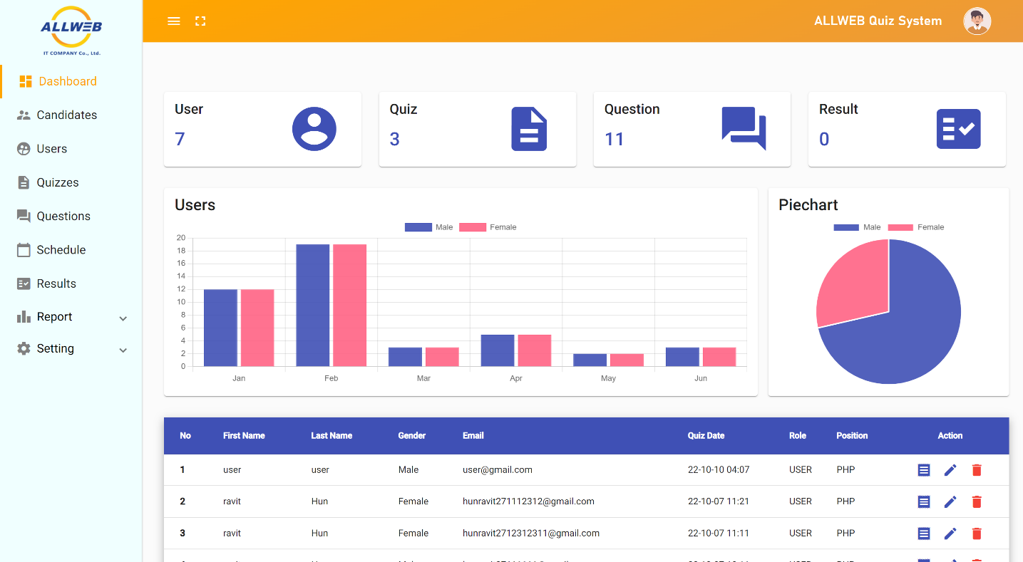
1. INTRODUCTION
1.3 What is ALLWEB Online Quiz for Recruitment?
ALLWEB Online Quiz for Recruitment is a website project to digitalize the traditional quiz paper to adapt to the new age of IT evolution. It will test all shortlisted candidates applying for any position with ALLWEB Co., Ltd.
Notes:
ALLWEB Online Quiz for Recruitment is a website project to improve the company working on a shortlisted candidate that applies for any position with ALLWEB company. And It also digitalizes from quiz paper to quiz in the system to adapt to the new age of IT evolution.

Slide 7

1. INTRODUCTION
1.4 Problems Overview
The reason that we propose to build this system is:
Wasted the recruitment working time printing out the quiz
The limited question and static order
Difficult to keep historical records of candidate
Difficult to manage time for each test

Slide 8

1. INTRODUCTION
1.5 Objectives
Build a website application that can provide:
Automatically set the quizzes for the candidate
Able to manage time
Can calculate the points
Random order questions
Store candidate information and result
Many types of questions

Slide 9
1. INTRODUCTION
1.6 Project Scope
ALLWEB Online Quiz for Recruitment
1
2
3
User and access management
Quiz management
Report management
Login and Register
User Roles
Access control of each roles
Manage quiz, quiz type and quiz level
Manage question, question type, question level, duration of the question
Manage answers, score
Report of candidate
Sending email to Admin, Recruiter
Automatic score of the quiz

Slide 10
1. INTRODUCTION
1.7 Planning
Tasks | Weeks
 | 1 | 2 | 3 | 4 | 5 | 6 | 7 | 8 | 9 | 10 | 11 | 12
Learn new technology
Analyze and design the project requirements
Implementation
Testing
Deployment

Slide 11
ANALYSIS AND DESIGN
2

Slide 12
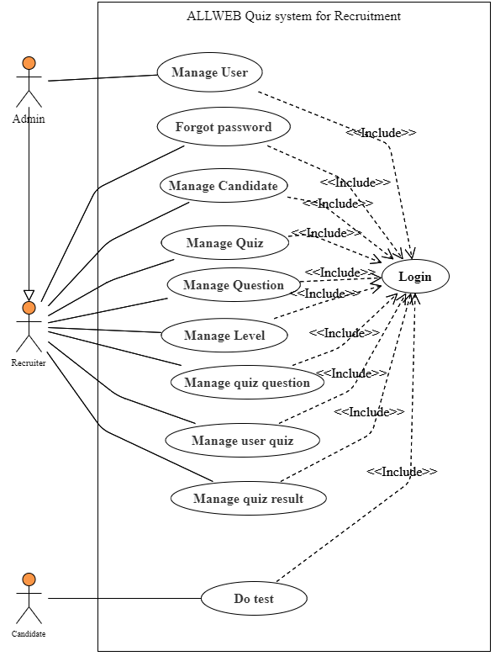
2. ANALYSIS AND DESIGN
2.1 Use Case Diagram
Admin
Recruiter
Candidate

Slide 13
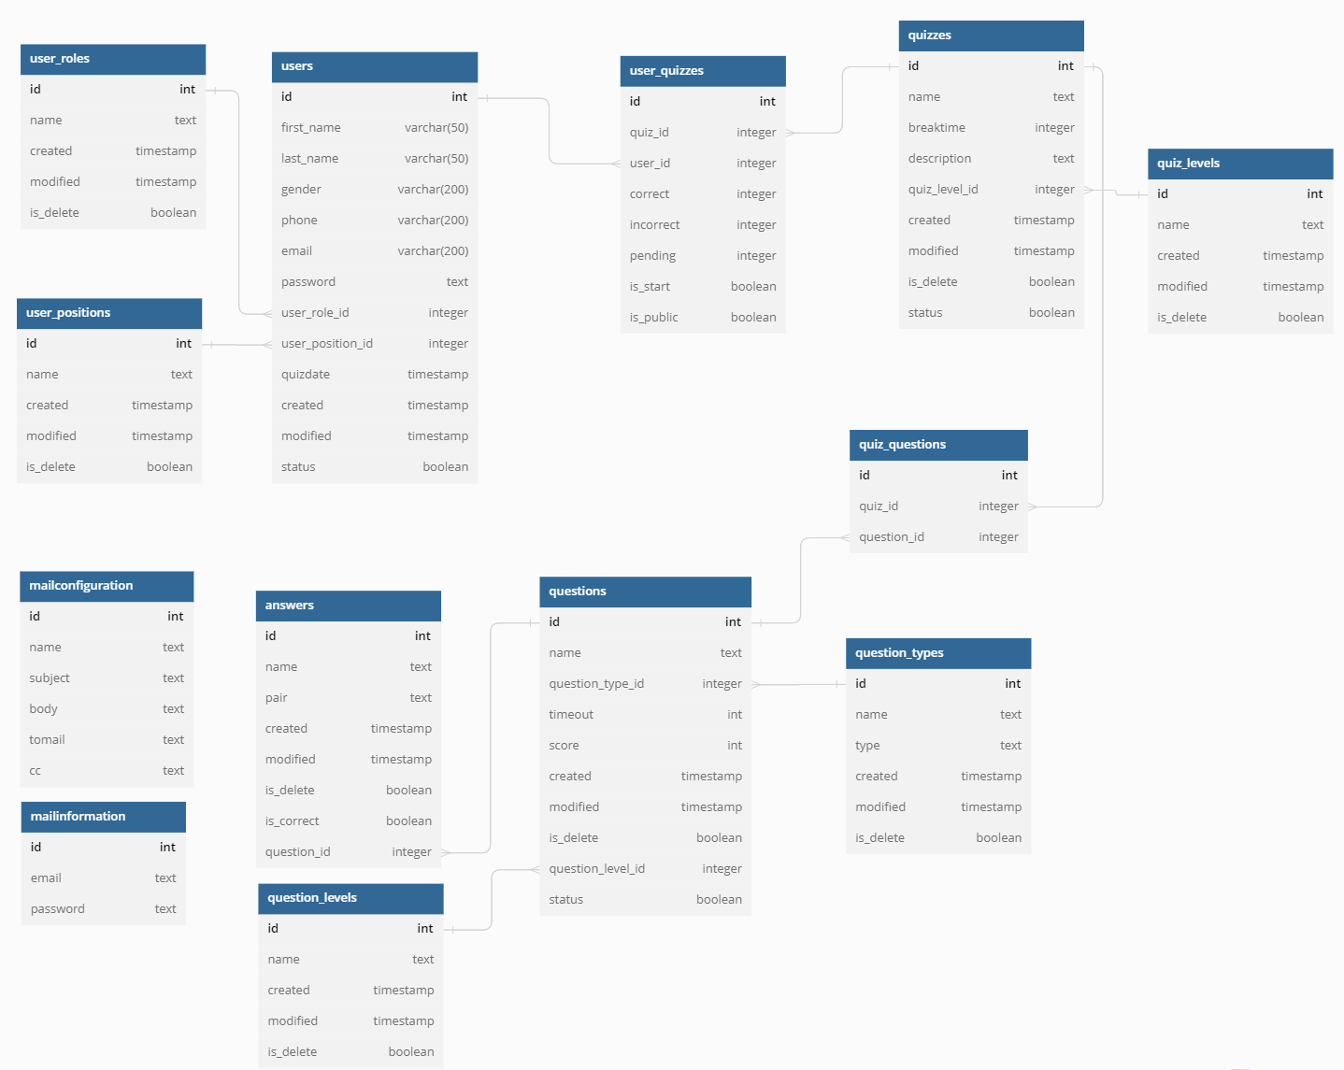
2. ANALYSIS AND DESIGN
2.2 Database Schema

Slide 14








2. ANALYSIS AND DESIGN
2.3 Choice of Technologies
Technologies
Tools
Database

Slide 15
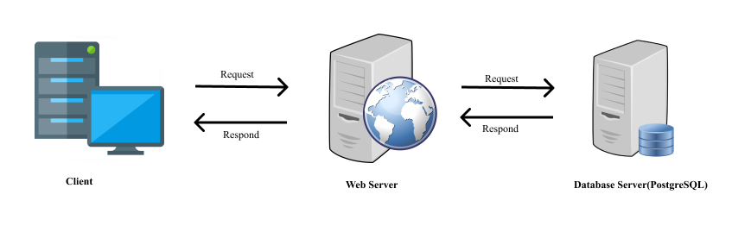
2. ANALYSIS AND DESIGN
2.4 Physical Architecture

Slide 16
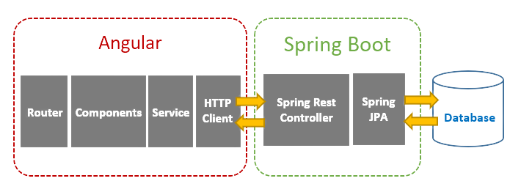
2. ANALYSIS AND DESIGN
2.5 Logical Architecture

Slide 17
IMPLEMENTATION
3

Slide 18
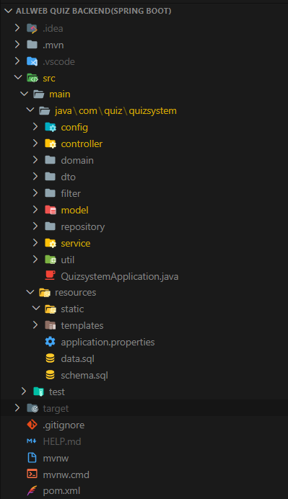

3. IMPLEMENTATION
3.1 Project Structure
config: store configurations like mail service
dto: store data transfer object(request & response)
repository: keep all repository
utils: keep feature specifics

Slide 19
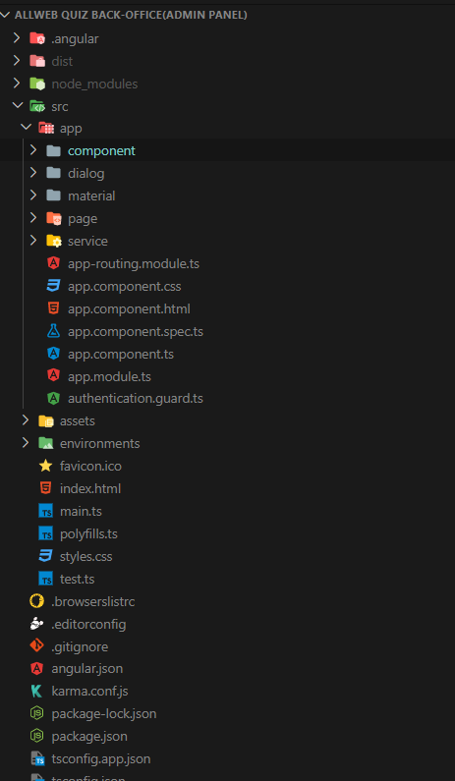

3. IMPLEMENTATION
3.1 Project Structure
component: store component that is re-used multiple time
assets: store image and third-party Javascript files
service: store service for communicating with API
page: store all pages design
dialog: store dialog of create, update, and delete

Slide 20
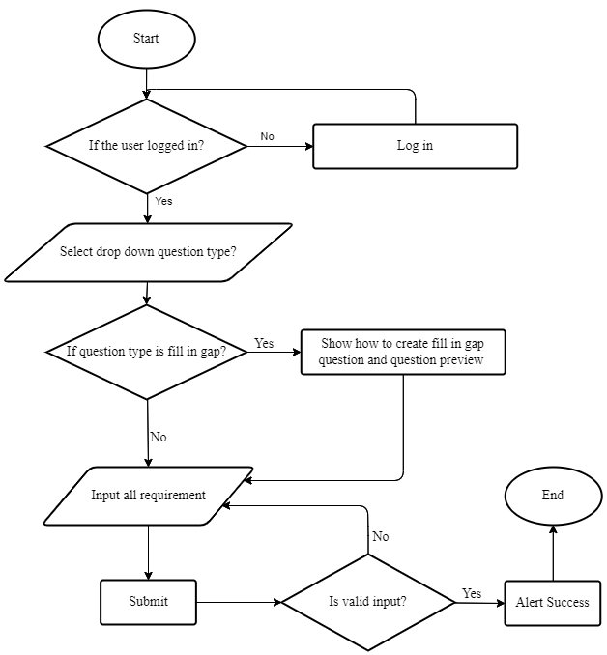
3. IMPLEMENTATION
3.2 Flowchart for create question

Slide 21
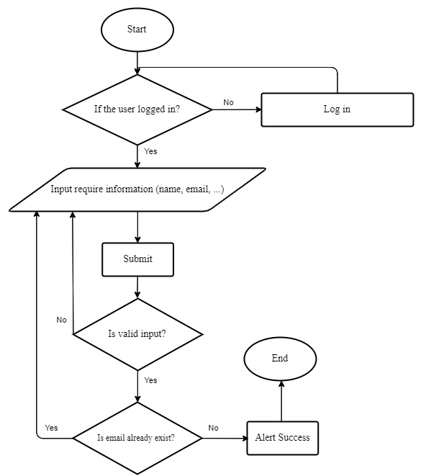
3. IMPLEMENTATION
3.3 Flowchart for create candidate

Slide 22
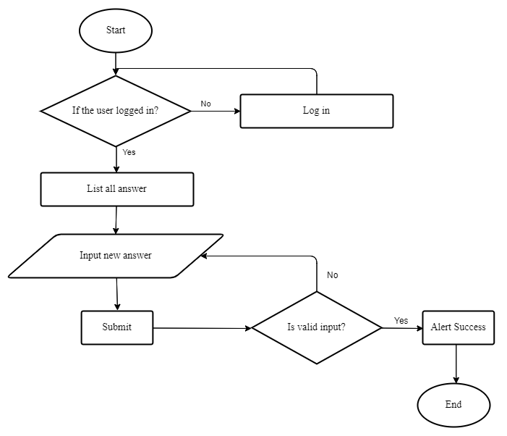
3. IMPLEMENTATION
3.4 Flowchart for editing multiple answers

Slide 23
CONCLUSION
4

Slide 24
4. CONCLUSION
Result
Task | Completed | Uncompleted
Login authentication | ü
Dashboad | ü
CRUD candidate | ü
CRUD user | ü
CRUD quiz | ü
CRUD question | ü
CRUD answer | ü
Assign and remove question | ü
Assign and remove quiz for user | ü
CRUD quiz level | ü
CRUD question type | ü
Update profile information | ü
Forgot password and reset password | ü
Generate report of candidate | ü
Configuration mail | ü
Configuration mail template | ü
Mail sender | ü
User result |  | û

Slide 25
4. CONCLUSION
Difficulties
Experiences
Dealing with new technology
Learning project structure
More requirements in the project
Learn new technology
Better teamwork
Project management and process
Understand environmental work

Slide 26
4. CONCLUSION
Perspective
Improve responsive website
Improve code structure
Add new technology to the project(Web socket, Autocorrect code)

Slide 27
DEMONSTRATION
5

Slide 28

THANK YOU
&
QUESTIONS

Slide 29
REFERENCE
Java Programming Language. (n.d.). Retrieved October 14, 2022, from https://docs.oracle.com/javase/8/docs/technotes/guides/language/index.html
Spring Boot. (n.d.). Retrieved October 14, 2022, from https://spring.io/projects/spring-boot
Introduction to HTML. (n.d.). Introduction to HTML. Retrieved October 14, 2022, from https://www.w3schools.com/html/html_intro.asp
CSS Introduction. (n.d.). Retrieved October 14, 2022, from https://www.w3schools.com/css/css_intro.asp
JavaScript.com. (n.d.). Retrieved October 14, 2022, from https://www.javascript.com/
Angular—What is Angular? (n.d.). Retrieved October 14, 2022, from https://angular.io/guide/what-is-angular
Angular Meterial, A. C. (n.d.). Angular Material. Angular Material. Retrieved October 14, 2022, from https://material.angular.io/
FullCalendar—JavaScript Event Calendar. (n.d.). Retrieved October 14, 2022, from https://fullcalendar.io/
PostgreSQL, P. G. D. (2022, October 14). PostgreSQL. PostgreSQL. from https://www.postgresql.org/
GitLab. (n.d.). Retrieved October 14, 2022, from https://about.gitlab.com/
IntelliJ IDEA: The Capable & Ergonomic Java IDE by JetBrains. (n.d.). JetBrains. Retrieved October 14, 2022, from https://www.jetbrains.com/idea/
Visual Studio Code—Code Editing. Redefined. (n.d.). Retrieved October 14, 2022, from https://code.visualstudio.com/
pgAdmin—PostgreSQL Tools. (n.d.). Retrieved October 14, 2022, from https://www.pgadmin.org/
Postman API Platform | Sign Up for Free. (n.d.). Postman. Retrieved October 14, 2022, from https://www.postman.com/
Spring Initializr. (n.d.). Spring Initializr. Retrieved October 14, 2022, from https://start.spring.io

